Slide 1
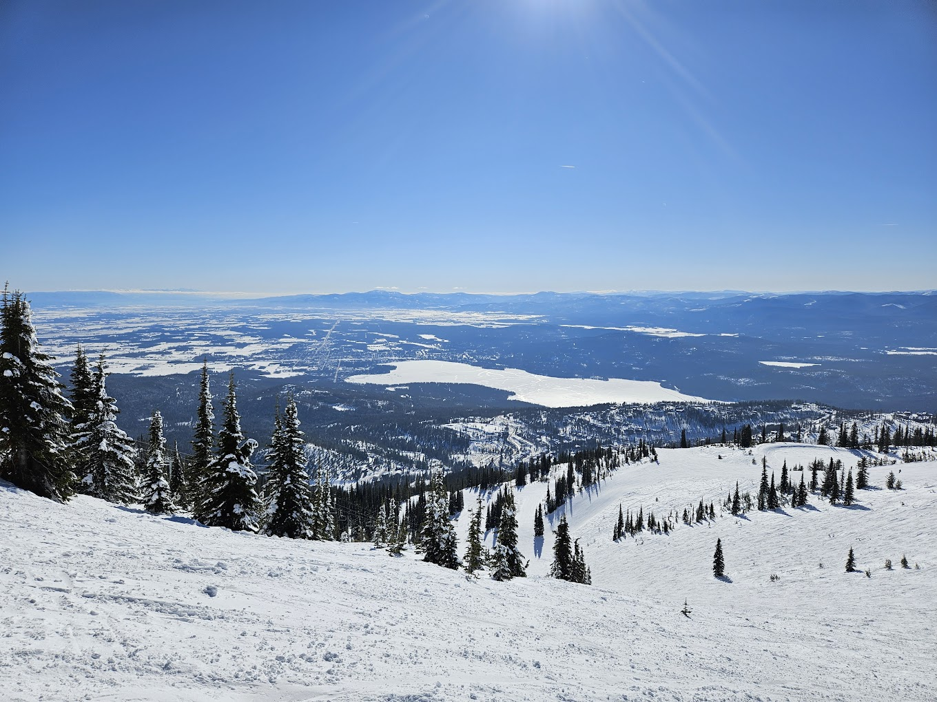
Big Mountain Resort Report

Slide 2
Problem identification
Reviewing potential scenarios for either cutting costs or increasing revenue (from ticket prices) for Big Mountain Resort.
Key data: Data information from 330 resorts in the US that can be considered part of the same market share.
Criteria for success: Cutting costs and strategy for ticket price without impacting investment strategy.

Slide 3
Context, Constraints, and Scope
Seeking guidance on reducing costs without lowering ticket prices or exploring the option of a higher ticket price to find better value.
Focusing solely on the market average for pricing doesn’t give the business a clear understanding of the relative importance of different facilities. This can negatively impact investment strategy.
Raising the ticket price carries inherent risks that can negatively impact the overall investment strategy.

Slide 4
Recommendation and key Findings
Increasing the price ticket by 10 dollars would not impact investing strategies and increases revenue
Closing down one run at Bing Mountain Resort makes no difference in terms of revenue. So it reduces the costs.
Recommendation:
Closing one of the runs and also increasing the ticket by 10 dollars.

Slide 5
Modeling Results and Analysis
Models:
Linear regression and random forest
We trained cross-validation for estimating linear regression model performance, and we checked that it gives a smaller Mean Absolute Error (MAE) and Mean Squared Error (MSE) with respect to the mean.
We calculate the mean absolute error using cross-validation. The random forest model has a lower cross-validation mean absolute error by almost $1 with respect to the linear regression model. It also exhibits less variability. Verifying performance on the test set produces performance consistent with the cross-validation results.

Slide 6
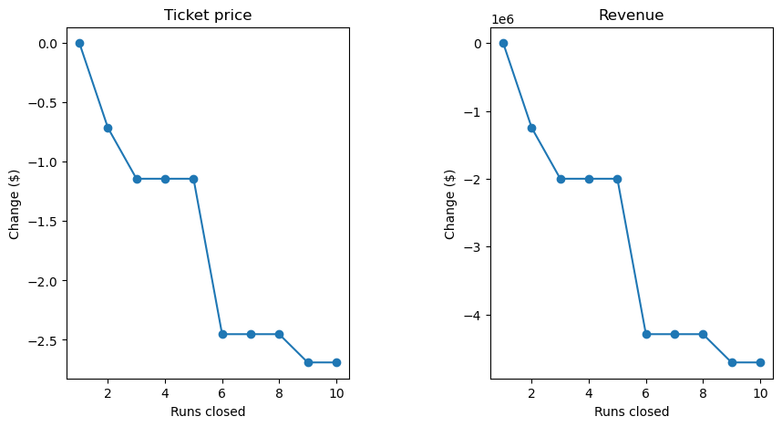
Closing down runs
Closing down one run at Bing Mountain Resort makes no difference in terms of revenue.
Closing 2 and 3 successively reduces support for ticket price and so revenue.
If Big Mountain closes down 3 runs, it seems they may as well close down 4 or 5, as there's no further loss in ticket price.
Increasing the closures down to 6 or more leads to a large drop.

Slide 7
Some Findings
Increase the vertical drop by extending a run 150 feet lower. This would require installing an additional chair lift to bring skiers back up but would not require extra snowmaking coverage.
This option is the same as option 1, but it includes adding 2 acres of snowmaking coverage.
Increase the length of the longest run by 0.2 miles, bringing it to a total length of 3.5 miles. This would require an additional 4 acres of snowmaking coverage.
1, 2, and 3 will not impact pricing
Random Forest model shows that an increase of 10 dollars to the weekend ticket price increases the revenue and has no impact on market share.

Slide 8
Summary and conclusion
The modelling performed here is constrained by deficiencies in the data set, such as the lack of information about other factors, such as service quality and customer demand.
To get a more accurate picture, information about the following costs would help: maintenance costs, labour costs, marketing and advertising expenses, utility costs, and insurance and safety costs.
Our final recommendation to the Executive Board is to close one run and also increase the adult's weekend ticket price by 10 dollars.

